Slide 1
EE
Week 3
Technical Communication Skills
CLO-1
Notes:
ss

Slide 2
The modern Internet originated from ARPANET, a project launched in 1969 by the United States Department of Defense. In 1983, the adoption of the TCP/IP protocol standardized data communication across networks. The invention of the World Wide Web by Tim Berners-Lee in 1989 transformed the Internet into a global information system. By 2000, internet access had expanded rapidly, reshaping communication, commerce, and education worldwide.

Slide 3
What is the text about?
Is it academic or informal?
Would this text help for an assignment?

Slide 4
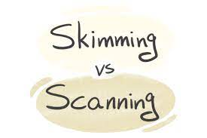
Learning Objectives:
By the end of this session, you will be able to:
Skim a text to get the main idea quickly
Scan a text to find specific information fast
Read critically to question, analyze, and evaluate ideas
Build new vocabulary (the bonus of reading ☺)

Slide 5

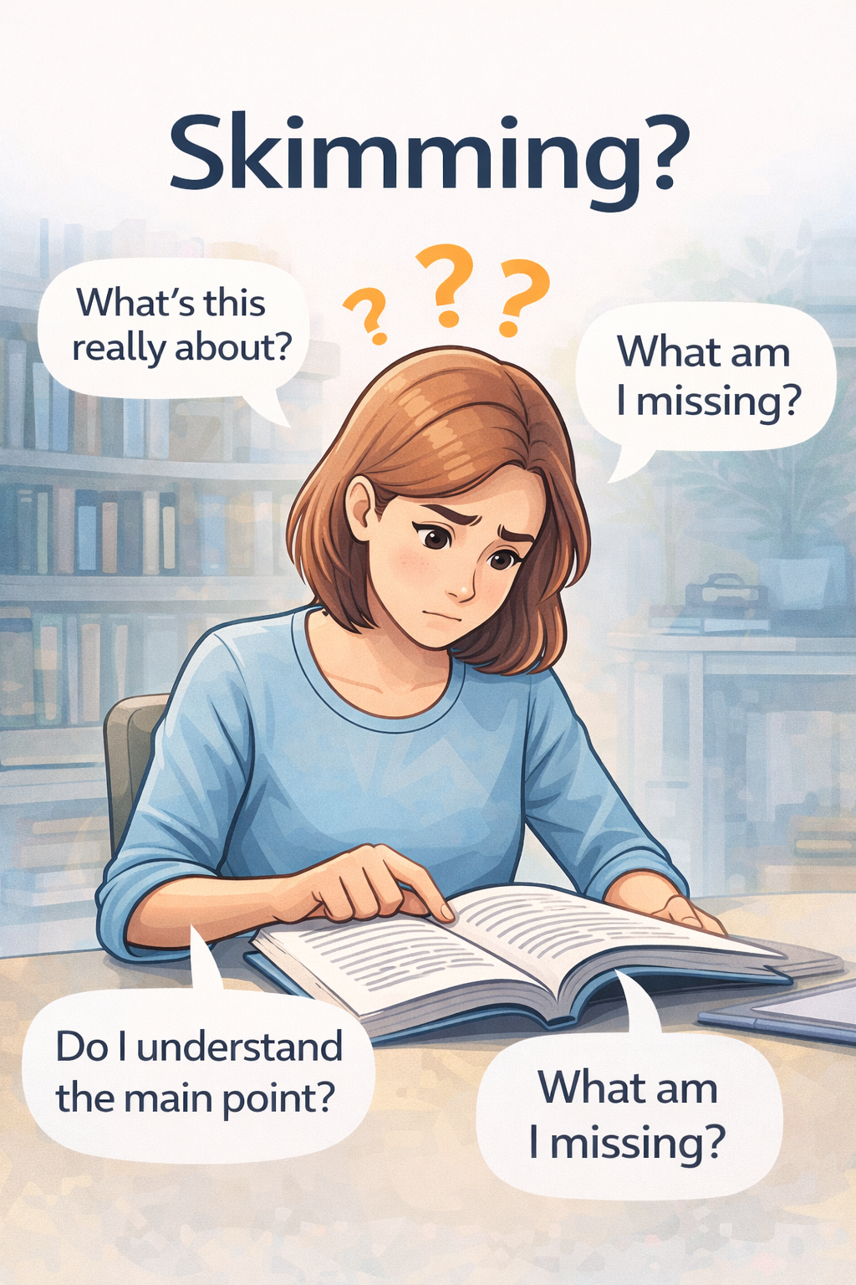
Skimming is a fast-reading technique used to get the general
idea of a text without reading every word.
Notes:
Skimming is a fast reading technique used to get the general idea of a text without reading every word.

Slide 6
Reading Skills :
Skimming
Scanning
Critical Reading

Slide 7
Skimming helps you to:
When skimming, you read:
Understand the main topic
Identify the overall structure
Decide if the text is useful or relevant
Save time when reading long materials
Title and subtitles
Introduction and conclusion
First and last sentences of paragraphs
Highlighted words, bold terms, or italics
Graphs, charts, or images

Slide 8
When Do We Use Skimming?
Before reading an article in detail
When previewing a chapter before class
During exams to understand questions quickly
When checking if a source is worth reading
Scanning lets you understand:
  The topic
  The author’s main argument
  The organization of ideas

Slide 9
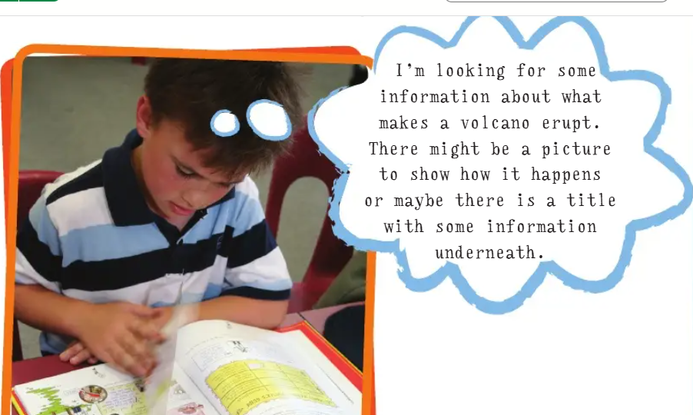
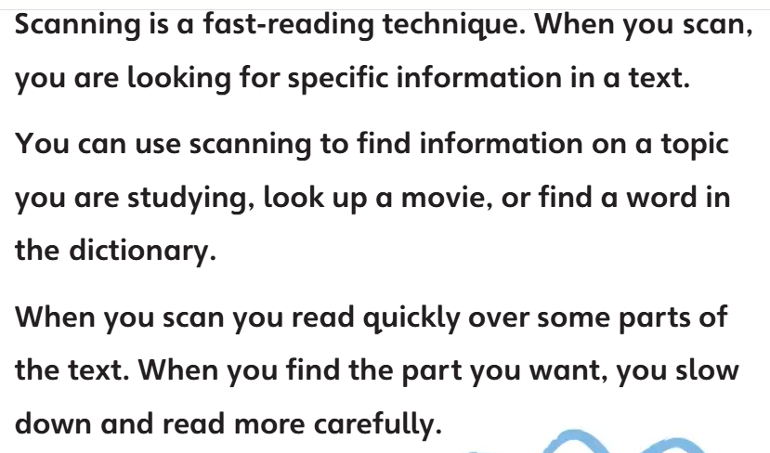

Slide 10
Scanning is a fast-reading technique used to find specific information in a text without reading everything.
When scanning, you:
Decide what information you need first (a date, name, number, keyword)
Move your eyes quickly down the page
Focus on:
Numbers
Capital letters
Keywords
Headings, tables, lists

Slide 11

When Do We Use Scanning?
Looking for a date in a history text
Finding a definition in a textbook
Checking a price or time in a schedule
Answering exam questions
Searching for a keyword in an article
Scanning is a reading strategy used to quickly locate specific information in a text.

Slide 12
Reading Strategies
Preview ➔ Plan ➔ Annotate ➔ Summarize important information
Find ➔ WHO, WHAT, WHEN, WHERE, WHY, HOW
Ask Qs. ➔ Define New Words ➔ Know-Want to Know
Connect to : ◆ Self ◆ World ◆ Other Texts

Slide 13
Annotating the text with Marginal Notes
What to annotate in a text for skimming
Memorable statements or important points
Central issues or themes
Your response to a specific point or passage
Examples that support a main point
For Scanning
Unfamiliar words
Questions about a point or passage
Key terms or concepts

Slide 14
Which event mentioned in the paragraph happened first, and what was its significance in relation to later developments and also provide title?
Between 2016 and 2024, global cybersecurity incidents increased by 62 percent, according to 2023 industry reports. A 2019 EU data regulation strengthened privacy compliance, while 2021 ransomware attacks disrupted healthcare systems worldwide. By 2022, organizations invested heavily in zero-trust architecture, and 2024 forecasts predict AI-driven threat detection will redefine digital risk management strategies globally.

Slide 15
Global Cyber security Developments and Policy Shifts (2016–2024)
The earliest event mentioned was in 2016, when global cyber security incidents began rising significantly. This increase was significant because it set the stage for later developments, including the 2019 EU data regulation, the 2021 ransomware attacks, and the 2022 shift toward zero-trust architecture. The growing threat landscape pushed organizations to strengthen security strategies and adopt advanced protection measures.

Slide 16
Analysis and Evaluation of the text with Qs.
For Skimming:
What is the main point or thesis of the text?
What is the author’s purpose or why does the writer want to make this point?
Does the writer take a position on the subject and adequately support it?
Patterns of organization used by the author?
How does the pattern/s of development suit the subject and purpose of the writing?
Anything noteworthy in the pattern/s of development?
Clarity and Effectiveness of the essay?

Slide 17
For Scanning
Where is the thesis statement located?
What example does the author use in paragraph 3?
Which term is defined in the introduction?

Slide 18
Critical reading
It is an active and thoughtful way of reading in which the reader goes beyond understanding the words on the page to analyze, question, and evaluate a text.
Critical reading helps students to:
Succeed in academic reading and writing
Think independently
Avoid misinformation
Make informed decisions
Develop strong analytical and reasoning skills

Slide 19
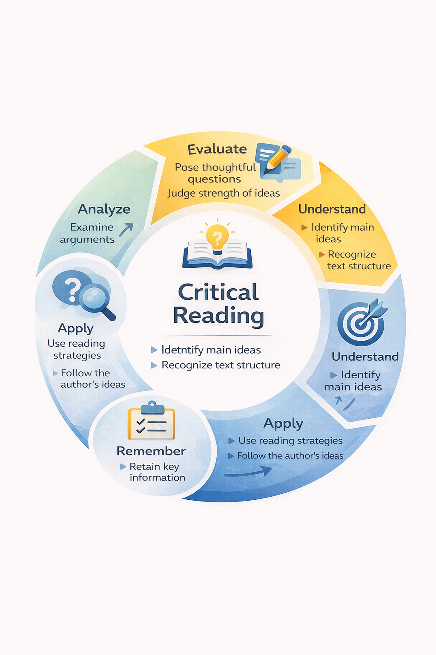
The Critical Reading Process

Slide 20
Purpose of Critical Reading is to:
Remember
Retain key information from the text
Recall important ideas and details
Understand
Stay focused while reading the text
Identify the main idea or central argument
Understand the overall structure and organization of the text
Apply
Use reading strategies to remain engaged with the text
Apply understanding of structure to follow the
author’s ideas

Slide 21
(Cont’d )Purpose of Critical Reading is to:
Analyze
Examine how ideas are developed and organized
Identify main ideas and supporting details
Evaluate
Pose informed and thoughtful questions about the text
Evaluate the effectiveness and strength of the
author’s ideas

Slide 22
Charity and Social Responsibility
Charity occupies a complex position within modern social welfare systems. While charitable organizations provide immediate relief through donations and humanitarian aid, critics argue that such interventions often fail to address structural causes of inequality. Overreliance on charity may obscure the responsibility of governments to implement sustainable social policies. Nevertheless, when integrated with institutional reform and community engagement, charity can play a meaningful role in promoting social justice and collective responsibility.

Slide 23
Questions
Q1. What kind of help do charitable organizations provide according to the text?
Q2. What long-term issue does charity fail to address, according to critics?
Why does the author believe charity should not replace government action?
Q4. How does the author describe the role of charity when combined with reform and community engagement?
Q5. Identify one contrast the author makes between charity and structural solutions.
Q6. Do you think the author’s argument about charity and government responsibility is convincing? Give one reason.

Slide 24
Answers
Immediate relief through donations and humanitarian aid.
The structural causes of inequality.
Because governments are responsible for long-term social policies.
It promotes social justice more effectively.
Charity offers short-term relief, while structural solutions create long-term change.
Yes, because charity alone cannot solve systemic problems.

Slide 25
Label the questions
Remember
What role does charity play in modern social welfare systems?
According to the text, what do charitable organizations provide?
Understand
Why do critics believe charity does not address structural causes of inequality? How does the author describe the relationship between charity and government responsibility?
Apply
How could the ideas in this text be applied to a real-world social welfare issue?/In what situation might charity be most effective according to the author?

Slide 26
Label the questions
Analyze
How does the author contrast immediate relief with long-term solutions?/What assumptions does the author make about government responsibility?
Evaluate
Do you agree that overreliance on charity can obscure government responsibility? Why or why not?/How convincing is the author’s argument about integrating charity with institutional reform?
Create
Propose a model in which charity and government work together to address social inequality.Write a brief thesis statement responding to the author’s view on charity

Slide 27
How to approach unfamiliar words:
1. Identify terms and their definitions
2. Analyze word parts
3. Guess meaning in context
4. Ignore less-important unfamiliar words

Slide 28
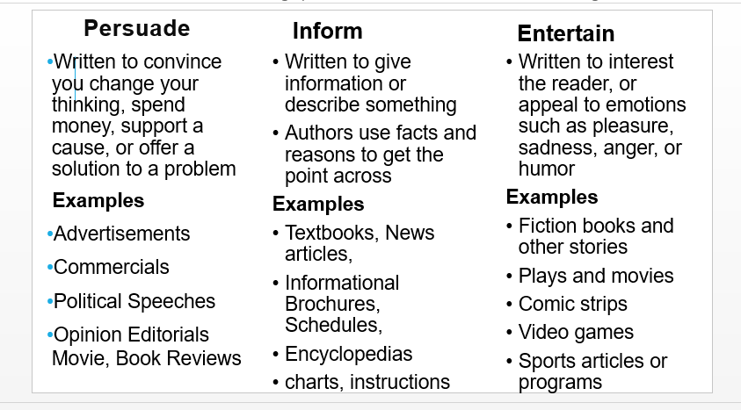
Author’s Purpose

Slide 29
Key Words
to Persuade Influence Encourage Convince Prove Urge Sell Inspire Convert Assure | to Inform Understand Show Describe Educate Discuss Explain Teach Give information Illustrate | to Entertain Tell Share an experience Relate Provide details Create

Slide 30
Question Stems: Short phrases or prompts to formulate questions
Informative Purpose:
  What is the primary goal of the author in....?
  How does the author aim to educate the reader about...?
  What information is the author trying to convey to the audience?
  In what ways does the author provide facts, data, or explanations to inform the reader?
Persuasive Purpose:
  What argument or viewpoint is the author trying to promote?
  How does the author use language and evidence to convince the reader of a particular perspective?
  What emotional appeals or rhetorical strategies does the author employ to persuade the audience?

Slide 31
Continued…
  What actions or beliefs does the author want the reader to adopt because of reading this?
Entertainment Purpose:
  How does the author use storytelling, humor, or creativity to engage the reader?
  What elements of the writing contribute to its entertainment value?
  Is the author aiming to captivate the audience's attention or provide an enjoyable reading experience?

Slide 32
Practice: Identify the author’s purpose
Water boils at 100°C under normal atmospheric pressure.
You should recycle plastic to protect the environment.
The puppy slipped on the floor, and everyone laughed.
Recent studies suggest that excessive screen time may be linked to reduced attention spans among young adults.
By choosing locally produced food, consumers can support small businesses and reduce carbon emissions.
The novel opens with a silent city, its empty streets reflecting the uncertainty of the people who once filled them.
Notes:
Answers
Inform
Persuade
Entertain
Inform
5. Persuade
6.Entertain

Slide 33
Identify the author’s purpose and explain your choice
A wave is any movement that carries energy. Some waves carry energy through water. Others carry energy through gases, like air, or solid materials. If you drop a rock into a pool of water, a wave, or ripple of energy, skims across the pool's surface. In the same way, an underwater earthquake can release energy into ocean water. Then it carries a giant wave, or tsunami, across the surface until it hits land. If you hear a clap of thunder, sound waves (or vibrations) have carried the crashing BOOM to your ears. Sound waves speed through the air at about 1,100 feet (335 meters) per second. Light also travels through the air in waves. They travel at more than 186,000 miles (300 million meters) per second. So the light waves from a flash of lightning reach your eyes before that clap of thunder reaches your ears! Electrons travel in waves, too. They move back and forth in a solid wire, sending waves of electricity so you can turn on a light during the storm!

Slide 34
What is the author's most important purpose for writing the selection?
to persuade readers to throw rocks into the water
to entertain readers with the legend of Wally Wave
to explain to readers how to use a surfboard to ride waves
to inform readers about different kinds of waves
Notes:
Answer . d

Slide 35
In one short paragraph (6–8 sentences), explain why waves are important in everyday life. Use at least two specific examples from the passage (such as sound waves, light waves, or water waves) to support your explanation.

Slide 36
IDENTIFYING ORGANIZATIONAL PATTERNS
Cause-effect: explores the causes and/or the effects of an event or state
Process: describes steps in a process
Classification: divides items into groups
Definition: defines a term or concept
Comparison: describes similarities between items
Contrast: describes differences between items
Comparison-contrast: comparisons and contrasts go parallel
Problem-solution.: illustrates a problem and its solution
Description: describes an event, state, person, or item
Notes:
Main ideas and supporting details are often organized in specific patterns, depending on the writer's purpose. For example, if the purpose is to show several effects of climate change, the writer will probably state the goal in the main idea sentence and outline the specific effects as supporting details. Certain words and phrases, including as a result of, causes, because, and due to, will point to the fact that the organizational pattern of this paragraph is cause-effect. The following are the most common organizational patterns used in academic writing. Often, a paragraph will have one central pattern, with elements of other patterns supporting it.

Slide 37
READING TIPS
Select the reading matter to suit the purpose
Select the reading strategy to suit the purpose
Plan reading time and environment – minimise interruptions and have note-making
materials to hand
Adopt an active, focused approach

Slide 38
READING STRATEGIES
Choose the strategy to suit the purpose:
Skim – for an impression
Scan – for an item
Read carefully for information and research.
To select reading matter for an assignment, skim, keeping your task in mind:
Read: the back cover, contents page and chapter headings to see if all or part of the book will be relevant; check section headings/conclusions for each chapter.

Slide 39
READING STRATEGIES
Consider: whether the book is on your recommended reading list; how recent and up to date it is; how readable and manageable it looks.
To locate a specific piece of information, e.g. a name in an index or directory, use the scan approach.
More in depth reading of your selected texts is needed to address your assignment.

Slide 40
BE AN ACTIVE READER
Adopt a questioning approach
Try the SQ3R method
Make notes of important points and ideas triggered by your reading which are relevant to your purpose.
Relate what you read to other information you’ve acquired on the same subject.
Make photocopies of important pages – highlight key words and phrases: make your own notes on them.
Check your understanding –
Pause after a few sentences and sum them up in your own words; write a summary of …

Slide 41
BE AN ACTIVE READER
key chapters/sections in your own words; chart the main ideas.
Vary your reading speed – fast for case studies, novels and well-developed arguments, slowly for texts with detailed information and unfamiliar, specialist vocabulary.
Predict what’s coming next, or what the conclusion might be.
Read critically – use your own judgement.
Keep a reading record.

Slide 42
THE SQ3R METHOD
Survey
Get an overview: read chapter summaries; first and last paragraph of each chapter; first sentence of each paragraph.
Question
Write down questions you hope to answer through your reading.
Read
Answer your questions
Recall
Ask yourself the questions and try to remember your answers
Review
Check your answers are correct

Slide 43
THE SQ3R METHOD
The SQ3R method is an effective reading strategy that helps you improve comprehension and memory. SQ3R stands for Survey, Question, Read, Recite, and Review. First, you survey the text to get an overview. Next, you form questions. Then you read carefully, recite key points in your own words, and finally review the material to reinforce learning.

Slide 44
QUESTIONS & ANSWERS
What does SQ3R stand for?
Survey, Question, Read, Recite, Review.
What is the purpose of the Survey step?
To get a general overview of the text.
Why do students ask questions before reading?
To read with a clear purpose.
What happens in the Recite step?
Students recall key points in their own words.
Why is the Review step important?
It helps retain information.

Slide 45
MAKING NOTES FROM YOUR READING
Keep your reading purpose in mind and work out in advance what information you need.
Don’t repeat information.
Sum up main ideas/ key points
Note exactly where the information comes from.
Note real names and quotations exactly as they were written.
Keep notes brief – avoid full sentences; use key words as memory triggers; use abbreviations.
Try pattern notes – they give an overview and show links and can be more memorable visually.

Slide 46
MAKING NOTES FROM YOUR READING
Leave spaces and a wide margin and use only one side of the paper so you can add new information.
Carry Post-it labels with you to note ideas that occur to you – stick them on a blank sheet in a plastic wallet.
Make your notes user-friendly – store in a loose leaf folder; number the pages; use headings; use a ruler to divide sections; draw squares round different sections in
different colours; link stray information by colour coding it; link points with arrows, colour, dotted lines, numbers

Slide 47
CRITICAL READING – QUESTIONS TO ASK
The Writer
Is the writer a reliable authority?
Has (s)he been mentioned by your tutor?
Is (s)he cited in other sources/bibliographies?
Is (s)he an accepted authority on the subject?
(May be an accepted authority on X but commenting on Y)
Is (s)he associated with a reputable institution?
What are the values/goals of that institution?
Vested interests (e.g. political, economic) involved?
Ideas more or less in line with other works on the subject?

Slide 48
The Audience
Aimed at a specialised or general audience?
The Publication
How reliable a source is it?
(Recommended textbooks and academic or professional journals more reliable than newspapers or magazines)
The Publication
How reliable a source is it?
(Recommended textbooks and academic or professional journals more reliable than
newspapers or magazines)

Slide 49
The content
At the right level or too simple/too technical?
Does it mainly cover facts or opinion?Is it up to date?
Has it received positive reviews?
The argument
What does the writer want you to accept?
Sufficient, relevant, reliable and valid evidence given?
Does the argument progress logically from one point to another?
Is the argument based on a sound premise?
Is the argument consistent? Any contradictions?
Is the argument balanced? Is the reasoning flawed in any way?
Any exceptions/missing info/reliable data?

Slide 50
Style and language
Easy to read?
Main points clearly presented?
Emotive language used? (e.g. unfair, massive, extremist, bureaucrats, fat cats)
Persuasive language used? (e.g. surely, clearly, obviously)
Any imprecise terms to describe data? (e.g. most, considerable)

Slide 51
Activity
In one paragraph (about 50 words), explain how scientific discoveries about waves over time have helped improve everyday life. Use at least two examples (such as sound waves, light waves, or electrical waves) in your answer.
Waves have been important in everyday life for centuries. In 1676, scientists first measured the speed of light, helping us understand why we see lightning before hearing thunder. By 1752, studies of electricity showed how energy travels through wires. Today, sound, light, and electrical waves continue powering communication and technology.

